Slide 1
Employee management System
Submitted to:
Prof. Rhyon Caldwell
By: Navpreet Singh Arora | Aashish Sidana

Slide 2
BSS: Employee Management System
Current System
A new restaurant in New Westminster is having hard time managing Employees data. The data is maintained manually using paper and pen. The inserting and updating of data require an average of 1.5 hours per day. Each new employee has a folder where data is collected. When Owner need to Calculate the pay, he searches the folder for the employee’s schedule.
The Problem
There are multiple problems:
1) Late/Incorrect Schedule- The employees do not receive the Schedule on time. Also, the shifts assigned do not match their given availability.
2) Pay – The employees sometimes got wrong pay. To eliminate this the BSS is created to automate the processes involved.
3) Data Loss – The data may get lost as it is done manually, and it is difficult to manage Active and Non active employees.

Slide 3
BSS: Employee Management System…
The Current System
The current system Note down the availability and other details of each employee in a paper sheet. Then the admin/owner consult the Employee folder to verify the details before making schedules and providing paychecks to Employees.
Example of Input Data:
· Date
· Schedule
· Work Hours
Proposed BSS:
The objective of the application is to make it easy for the owner to manage the data of the employees and to automate processes like Calculating Salary etc.

Slide 4
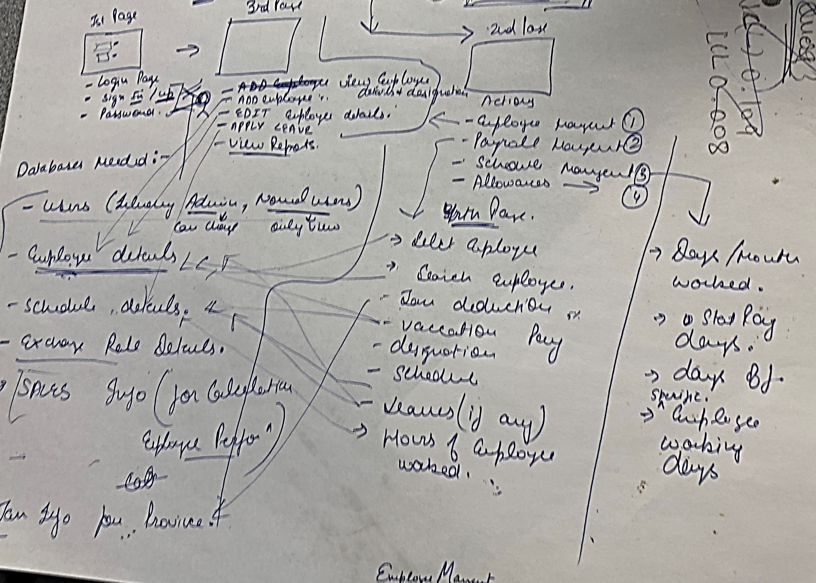
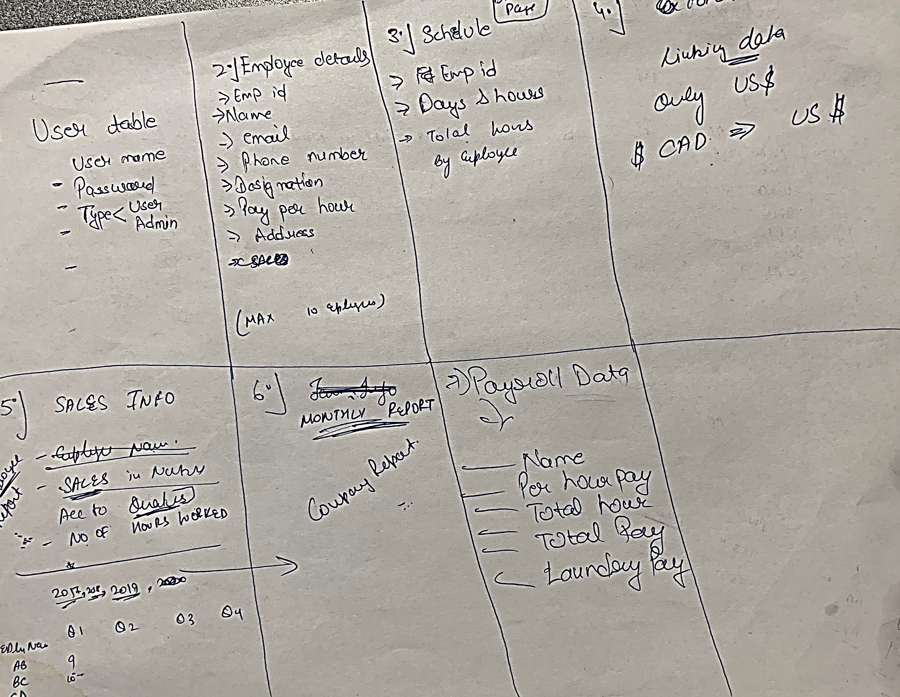
Blueprint: Flow of Data and Database

Slide 5

Login

Slide 6

Home Page

Slide 7
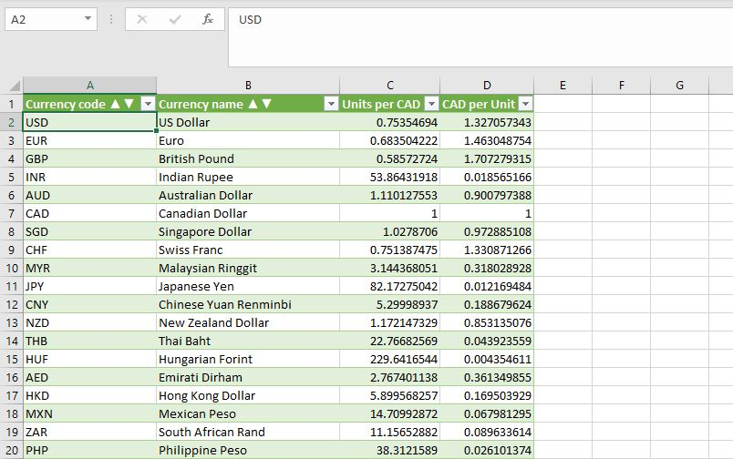
External Connections for Currency exchange

Slide 8
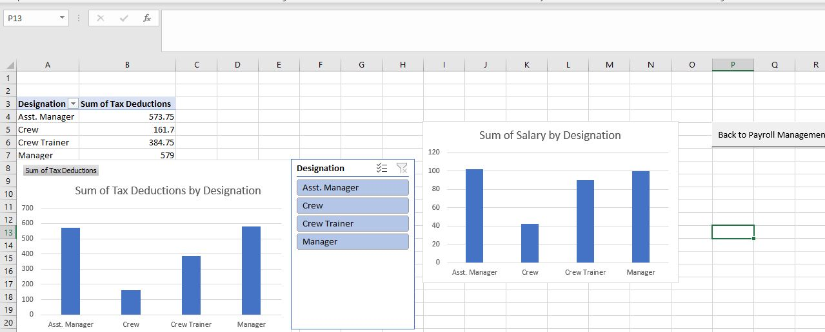
Charts and pivot tables

Slide 9
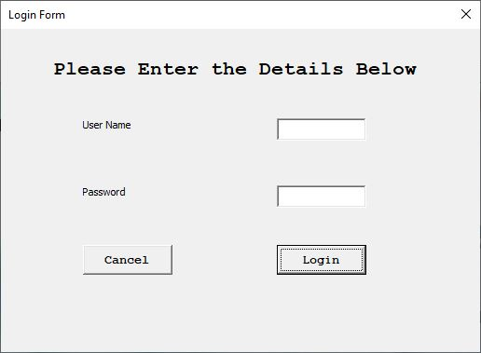
Login User Form

Slide 10
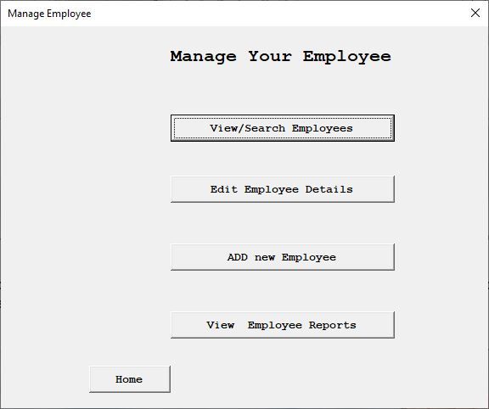
Employee management User Form

Slide 11
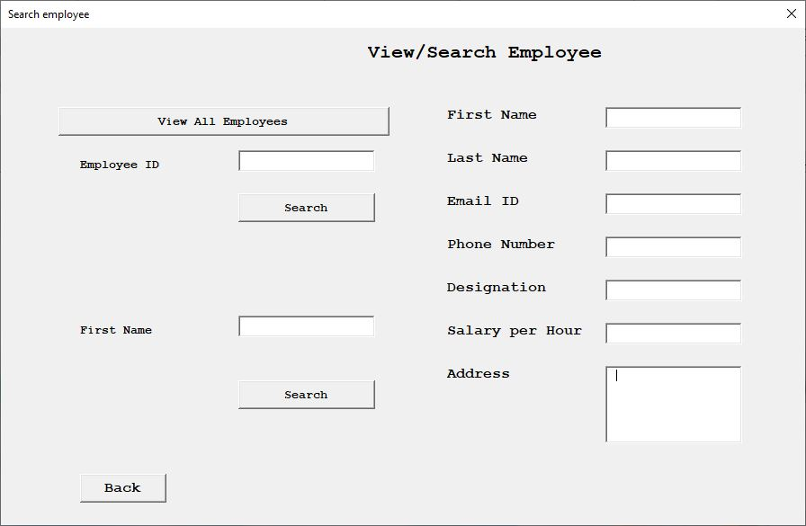
View / Search Employees

Slide 12
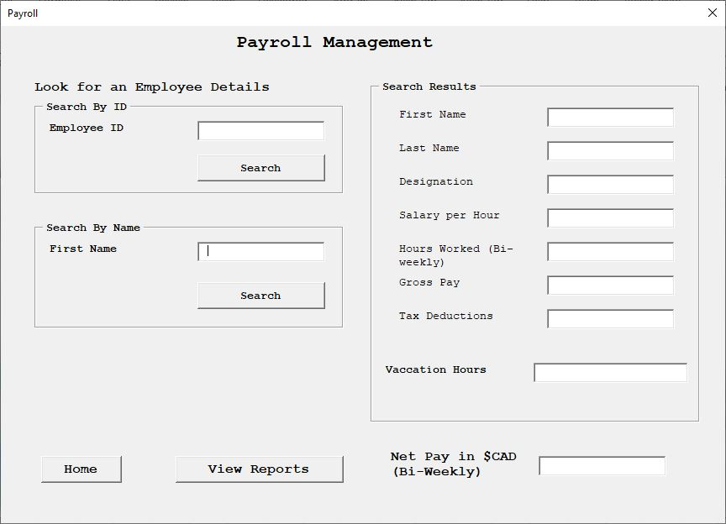
Payroll Management

Slide 13
Thank You

